Slide 1
Access to Research Infrastructure NSF Experience
Ed Seidel
Assistant Director
Directorate for Mathematical and Physical Sciences
National Science Foundation
October 1, 2010

Slide 2
NSF Supported Research Infrastructure: Two Broad Categories
User Facilities
Examples: National Astronomy Observatories, National High Magnetic Field Laboratory, National Center for Atmospheric Research, ALMA, National Center for Supercomputing Applications (NCSA)
Managed by university or consortium of universities
Scientific and technical staff to support users and conduct in-house research
Large “experiments”
Examples: LIGO, IceCube, LHC
Managed by university or consortium
Science performed by large collaboration
Frequently international
Collaboration sets access terms, data policy

Slide 3
NSF Supported User Facilities
NSF has supported major research user facilities and infrastructure throughout its history
Since founding of National Astronomy Observatories and National Center for Atmospheric Research (1957 – 1960)
Overriding principle - access is purely on the basis of scientific merit
Not limited to NSF grantees; open to world community
My EU Network made great use of NSF and DOE computing facilities! Led me to propose “EDSN” LOI in 2002 to EU!
Has fostered a legacy of scientific achievement, advances in technology and techniques, training of students, engagement of the public with the scientific enterprise

Slide 4
Broad Spectrum of User Facilities and Infrastructure
Telescopes, computer facilities, light sources, accelerators, research vessels, atmospheric radars….
Specifics of support and management vary with sociology of field, but:
Access based on scientific merit
Users do not pay operations costs – NSF stewards facility for the world community
Exception – industry use of light source for proprietary data, e.g.
ICFA-like model for large facilities, e.g., LHC now; DUSEL in future
International collaborations, e.g., Gemini, ALMA
Partners establish administration of time and access, through governing agreements
U.S. time open solely on basis of scientific merit

Slide 5
LIGO: Experiment Evolves to Facility
Laser Interferometer Gravity Wave Observatory (LIGO)
Discovery
Data access is restricted to an OPEN collaboration.
Anyone can join.
Also, via MOU, LIGO shares data with the Virgo collaboration and passes potential events to electromagnetic observatories (Swift, TAROT, QUEST).
Data associated with signals will be released as they are published, along with appropriate tools.
Observation
LIGO will establish a data center to release full data sets (after instrumental artifact removal) with appropriate tools and user support.

Slide 6
Possible Facilities Discussion Topics
Timescale for planning and realization (> 10 years?)
Retiring/re-purposing existing facilities
Training a new generation of builders as facility scale grows
User access policies
Data policies, including cost implications of access and long term stewardship/curation and services
Not just costs of data services, but also impact of data access policies on investments in facilities themselves.
Example: open skies policies for astronomy?
Models for collaborative undertakings

Slide 7
Thank You

Slide 8
Notes:
A network of detectors is the key to localizing sources on the sky. The Gravitational Wave International Committee, representing all such projects, has recently appointed a subcommittee to study how to make gravitational wave data more accessible.

Slide 9
But:LIGO is an open collaboration
Novel approach to expanding collaboration
Anyone may apply—procedure described on website
Previous experience with gravitational waves or physics is not required. All researchers welcome.
Example: Korean consortium with no previous connection to LIGO or gravitational waves will now assist in data analysis to learn methods and then try to develop their own approaches. Participants include astronomers, computer scientists, engineers, applied mathematicians,... Joined LSC 9/09.
Notes:
The collaboration is not just for physicists.

Slide 10
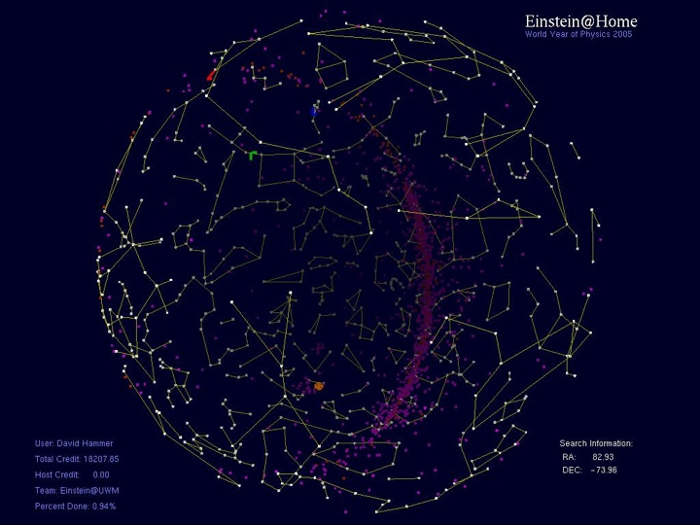
Public participation in LIGO research
240,000 users 1,000,000 computers
211 countries 210 TeraFlops
data is encrypted, unusable outside @home

Slide 11
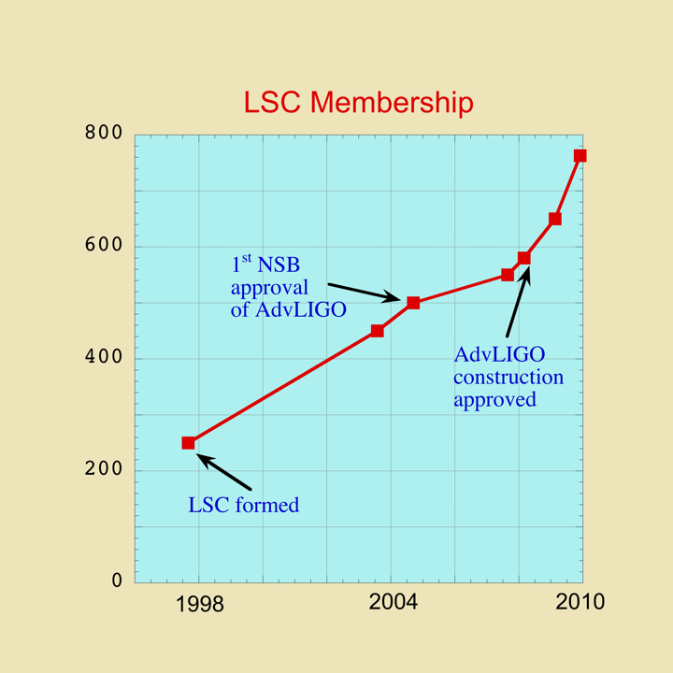
Is the collaboration open?
LIGO sensitivity astrophysically interesting during S5
Notes:
The collaboration has tripled in size since its formation and is currently growing exponentially.

